Slide 1
Barone2
Design Defense
Dylan Harootunian
Chin Ming Ryan Wong
Leonid Shuster
Jeremy Germenis
George Hernandez
Isaac Szu

Slide 2
The Problem With Drones
Drones are amazing tools of research that enable users to collect data quickly and safely but suffer from short flight times; short flights cost man-hours due to the constant need to swap out batteries and land the drone, making it difficult to conduct large surveys. The USGS is an example where they use a drone to collect magnetometer data to identify underground anomalies, however, they are limited to 15-minute flights that hinder their research. The USGS and other researchers need drones that can fly for extended periods of time to conduct their data collection with ease, so they have more time to conduct their research.
Notes:
Snake oil

Slide 3
Requirements from Client
Client: Jonathan Glen from United States Geological Survey gave us the following system requirements and why he would need them:
Minimum Drone Speed of 5 mph in up to 15 mph wind
Minimum Drone Flight Time of 30 minutes at minimum speed, but 60 minutes is desired
Magnetometer Payload Interference of Less Than 10nT
RC Control to maintain Stable Height and respond to user translational commands
Autonomous Control to collect data over a predetermined area, and must Include Terrain Tracking.
Costs of less than $10,000, but less than $6,000 is desired.
A noise level of less than 65 dB when 5 ft away from the drone.
Notes:
Can place quantified stuff here if the client gave it

Slide 4
The Barone is Not Successful in Meeting Client Requirements
Physical prototype built but failed to take-off in testing
Remote Control Implementation was tested in Matlab, but not yet verified in Vrep.
The remote control simulation along with some autonomous functionality will be tested in the next week
Autonomous Control has not been tested
Power draw test estimate drone theoretically meeting minimum flight requirements
The noise test preliminarily fails to meet requirement
The noise test will also be conducted again with some modifications and may meet the requirement.
The magnetometer interference test was not not conducted.
Costs is believed to be within requirement, however, we were unable to estimate overhead costs
We will conduct test in simulation for the Closed Loop RC and some autonomous functions in the next week.
Notes:
Synopsis, successful or no, where is it? Will it be successful is going to be worked on more? Keep this project level

Slide 5
Requirements Added By Team
Hidden slide
These other specifications were added as realistic requirements our drone must follow:
Drone Safety
Making sure any possible injuries and respective lawsuits are avoided
Helium Leakage
So that helium would not need to be bought excessively
Legal Requirements
We wanted availability to fly a drone on campus
Manufacturability
Parts needed for the drone should be readily available for fabrication

Slide 6
System Level Requirements For Drone
Minimum Drone Speed: Drone shall be able to fly at least 5 mph in winds up to 15 mph. Verified in V-REP
Drone is shown to meet requirement with ideal shape but not fabricated shape. No physical testing conducted
Drone Flight Time: Flight time shall be at least 30 minutes with payload. Power Test Verified, Test Flight Failed
Results of power draw tests used to make estimates, Attempted hovering test failed.
RC Control: Drone shall respond to user commands with pitch and roll angles within ±0.1 radians and a height of 1±0.15m.. Matlab Verified
Direct remote control of servos and motors has been implemented and tested, closed-loop is being tested in Matlab and Vrep.
Autonomous Control: Drone shall maintain stable pitch/roll/height and follow a path. Not Verified
Design not completed. Auxiliary autonomous functions such as take off and landing tested in Matlab
Cost: Drone shall cost less than $10,000. Estimated Product Cost
Completed BoM with costs and estimated for outsourced labor. Marketing and overhead not calculated
More on next slide

Slide 7
System Level Requirements For Drone Continued
Magnetometer Interference: Interference from drone shall be less than 10nT on payload Not Verified
magnetic field at payload site was unable to be tested with incomplete system
Drone Safety: The drone, its usage, and build should be safe to all individuals involved. Not Verified
Physical testing will determine the safety of the balloon
Helium Leakage: The lift bag shall maintain 90% of its buoyancy over a one week period. Tested:Not Met
Helium loss test to revealed that could lose 10% of its buoyancy in just 75 minutes.
Legal Compliance: The drone and team shall abide by all applicable laws for drone flight. Not Verified
Drone cannot be registered with FAA until it is a completed system.
Noise Level: The drone should be quieter than 65dB. Tested:Not Met
Noise Test results showed that at max throttle the drone could reach up to 76dB
Manufacturability: The drone should be able to be manufactured with equipment within our workspace. Not Verified
3D parts manufactured successfully, Envelope Fabricated but needs adjustments, PCB was not verified

Slide 8
Drone Minimum Speed was Verified in Simulation
Sim Verified
Requirement: Drone shall be able to fly at least 5 mph in winds up to 15 mph.
V-Rep Simulation was used to show that the requirement would be met if ideal shape was flown. Against a 15 MPH headwind, the drone reaches speeds of up to 7.8 MPH.
V-Rep Simulation was also used to show that the requirement would not be met if fabricated envelope V7 was taller than the ideal envelope shape. The drone was not able to move forward due to drag created from a 15 MPH headwind.
Conclusion: V-REP successfully verified that our ideal system would meet the technical requirement and our fabricated system would not.

Slide 9
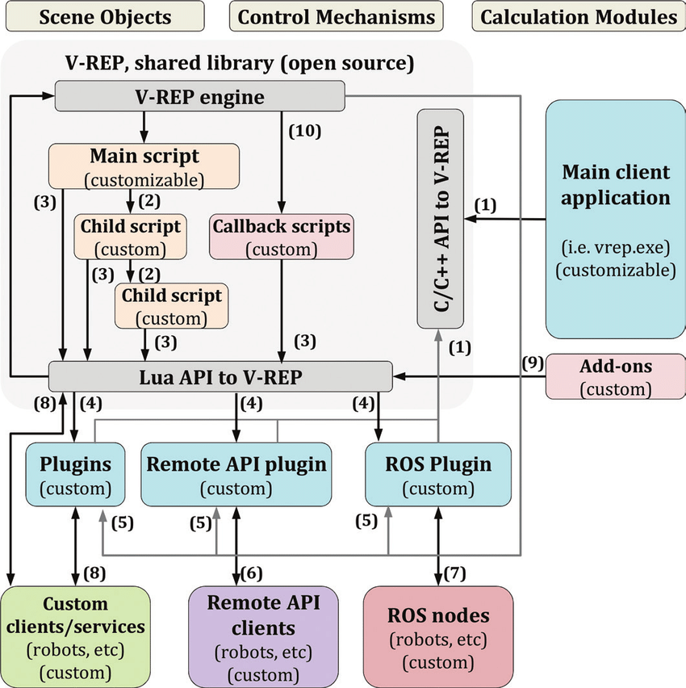
An Overview of Simulation Testing is Represented within this System Block Diagram
Hidden slide
1. Testing begins in V-rep with defining scene objects with Lua commands and importing those objects from CAD models
3. In order to apply closed loop remote control or autonomous functions, C/C++ remote API is used to interface with the Lua functions by providing input and output using built in remote API functions.
2. Lua functions are written as child scripts to operate with the defined objects. Servos and propellers are operated using these functions.

Slide 10

Drag, Nonlinear Propeller Thrust, and Max Thrust Implemented in V-rep to Test Drone Speed
System Requirement :Drone Speed
Expectation: With the ideal fabricated model and worst case wind conditions, drone flight should be completely feasible and achievable.
Procedure: By implementing drag and propeller forces scaled to the maximum thrust requirement, an open loop remote control system was built to simulate actual results in a physical testing environment.
General flight patterns of a simulated drone showing all features implemented.
Notes:
What’s the difference between the 2 vids

Slide 11
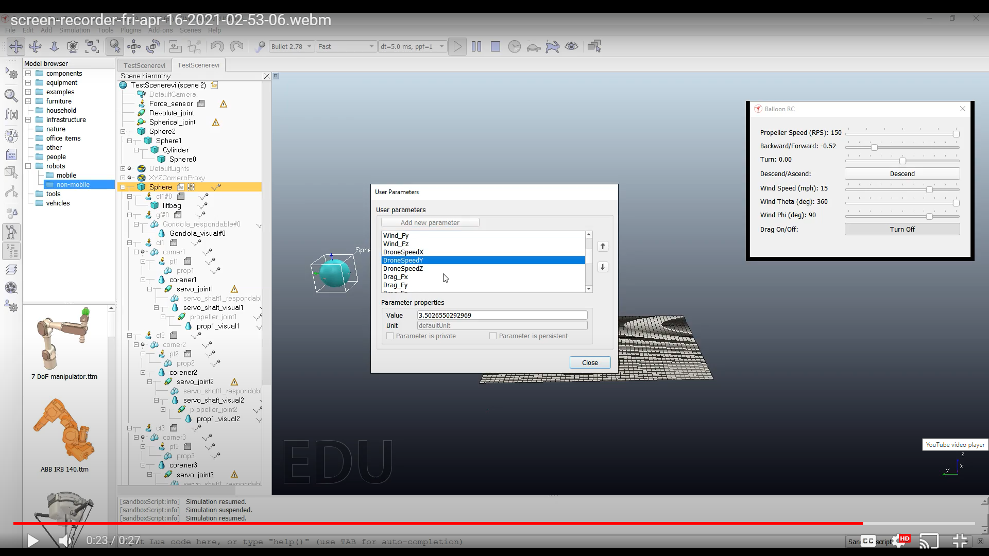
Speed Requirement is met with Ideal Drone Shape
System Requirement :Drone Speed
Requirement: Drone shall be able to fly at least 5 mph in winds up to 15 mph
Throttle Maxed to 2.5N
3.502m/s
15 MPH headwind
MPS to MPH
7.83MPH
Result: The drone was able to move 7.8MPH in a 15 MPH headwind.
Conclusion: The Ideal Drone was successfully able to meet the technical requirement inside of the V-Rep Simulation.

Slide 12
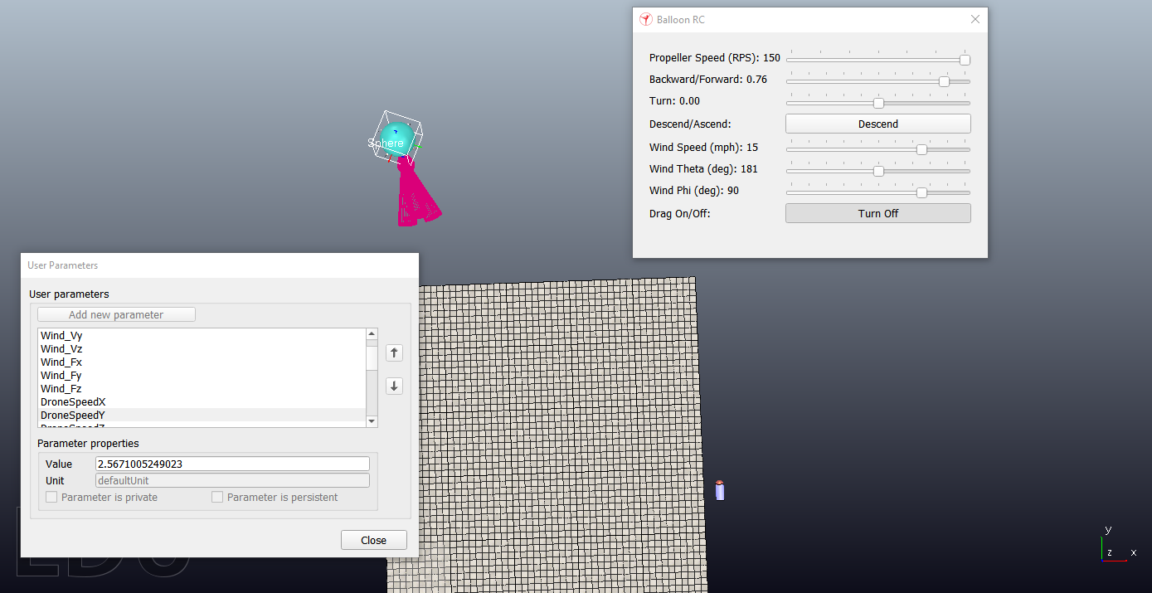
System Requirement :Drone Speed
Speed Requirement Was Not Met With the V7 Envelope Shape
An additional test was conducted to test the Speed of the drone with the differing fabricated shape of envelope V7
Throttle Maxed to 2.5N
15 MPH headwind
-2.567m/s
MPS to MPH
-5.97MPH
Results : With the V7 envelope creating 40N drag in a 15 MPH head wind the drone is pushed backwards even at max throttle
Conclusion: The drone with the V7 envelope shape can not fly forward into a 15 MPH headwind even at max throttle . This is due to the massive increase in drag between the ideal and fabricated versions.

Slide 13
Drone Flight Time Estimated Through Power Draw.
Power Test Verified
The drone shall fly for at least 30 minutes with magnetometer payload during normal autopilot flight. May fly for one hour as a stretch goal.
With max expected effective weight of 5N and max drag from wind of 8N, flight time can be determined with power costs of motors, servos, and passive components
This will be detailed in the following slides, but the minimum and maximum flight times are shown below:
Motors | Always Opposing Max Drag Flight Time | Hovering Only Flight Time | Satisfies Requirement?
(Intended)1275 kV with 20A 4 in 1 ESC | 40.2 minutes | 103.2 minutes | Yes
(Replacement)2600 kV with 4 single 30A ESCs | 30.6 minutes | 69.6 minutes | Yes
Conclusion: Replacement motors with twice the Kv rating of original motors paired with the new ESCs were very power inefficient, especially at our max thrust needed. However, since both of the motor versions can support maximum thrust needed for at least 30 minutes, we can verify that normal autonomous flight can last at least 30 minutes since autonomous flight would need to stop and take measurements.
Notes:
Redo

Slide 14
Current Power Costs of Drone
System Requirement :Drone Flight Time
Currently Expected Power compared to available battery Wh capacity of 101Wh:
Part | Sensors | Controller/Processor | Transmitters/ Receivers | Servos | Motors | Heat Loss | Total
Expected Power(W) | .419 | 6.38 | 4.37 | .12-7.0 | 84.3-173 (Simulated) | .94-2.8 | 100-194(1275kV)
Actual Power(W) | .159 | 2.80 | 4.06 | .04-7.0 | 50.8-135(1275kV) 79.3-181(2600kV) | .94-2.4 1.3-2.6 | 58.8-151(1275kV) 87.3-197(2600kV)
Energy(Wh) = Power(W) * Time(h) | 1275kV(Expected) | 1275kV(Real) | 2600kV(Real)
Max Power for .5 hour | 97Wh | 75.5Wh | 87.3Wh
Min Power for 1 hour | 100Wh | 58.8Wh | 98.5Wh
Conclusion: Max Power with the replacement motors was closer to the expected power values than the original motors, giving us a longer flight time than expected. Details for each part test will be shown in the following slides, although there were a few parts that were not able to be tested. Since non-tested parts amount to 1% of the system’s expected power, the flight time requirement can still be met.
Notes:
Redo

Slide 15
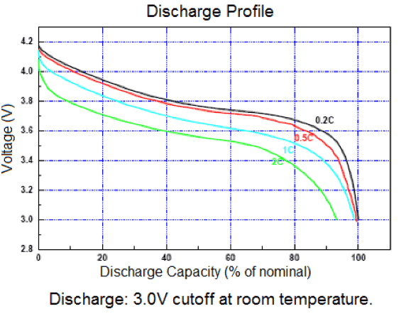
Battery Selection
Hidden slide
System Requirement :Drone Flight Time
Expected Power:
Parts | Sensors | Microcontroller/Microprocessor | Transmitters/ Receivers | Servos (Depends on activity) | Motors (Depends on activity) | Heat Loss
Expected Power(W) | .466 | 4.02 | 4.43 | 2.4 - 7 | 79.5-162 | 11.4
Total power expected to range from 94.7Wh for half an hour flight to 101.5Wh for one hour flight
Battery chosen as 3S Lipo to get max power from our motors, rated for 2-3S Lipo
Capacity chosen as 122.1Wh, assuming linear depth of discharge due to lack of a discharge curve and an alarm voltage of 3.2V per cell to avoid 3.0V battery breakdown voltage with a 4.2V max voltage per cell, 5/6th of this battery Wh capacity would be 101.7Wh, above requirements for half and full hour flights
Typical Lipo Discharge Curve: https://electronics.stackexchange.com
Shows large dip after 3.2V voltage after up to 90% current discharge at 2C
This means we chose a slightly larger battery than needed previously
Notes:
Add similar discharge curve

Slide 16
Higher Expected Battery Flight Times
Assuming 90% of total capacity is used instead of 83% previously used.
Motors | Always Opposing Max Drag Flight Time | Hovering Only Flight Time | Satisfies Requirement?
(Intended)1275 kV with 20A 4 in 1 ESC | 43.6 minutes | 112 minutes | Yes
(Replacement)2600 kV with 4 single 30A ESCs | 33.2 minutes | 75.5 minutes | Yes
Conclusion: Estimating a higher battery available capacity would allow us to further guarantee 30 minute flight time during autonomous flight and will be closer to the 1 hour stretch goal without affecting system weight.

Slide 17
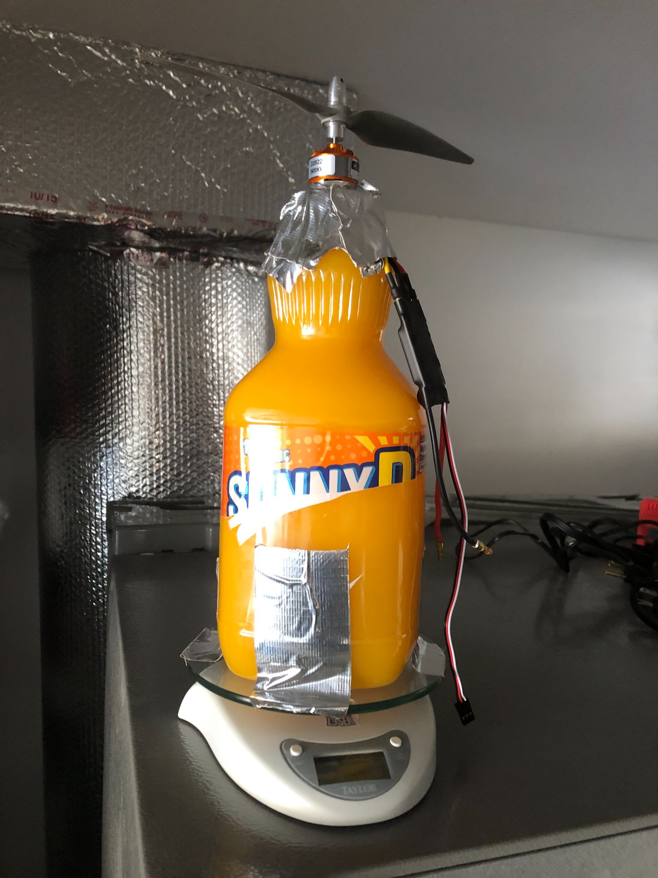
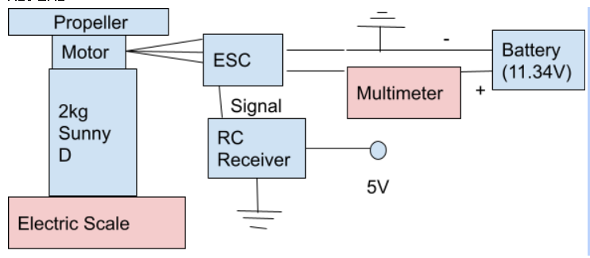
Motor Power Test Was Conducted
System Requirement :Drone Flight Time
Expectation: Original Motors will follow expected power curve from simulation, while the replacement motors will be much more power inefficient de to higher kV rating
Procedure:
Tape motor on top of 2kg Sunny-D Bottle that is taped to an electric scale, since one motor cannot lift 2kg
Connect Motor’s 3 inputs to ESC that is powered by the battery with the positive end going through a multimeter
Connect ESC signal to RC receiver, powered by 5V outlet and with a common ground to the battery
For every 5% of throttle, wait 3 seconds for current on the multimeter and weight change on the scale to stabilize and record
Repeat also when static thrust
approaches desired
values of 125g and 250g
The Sunny-D Test Scale
Setup
(Disassembled)
Limitation: Thrust unable to be tested in different wind conditions
Red = Measurement tool
Blue = System
Notes:
Done

Slide 18
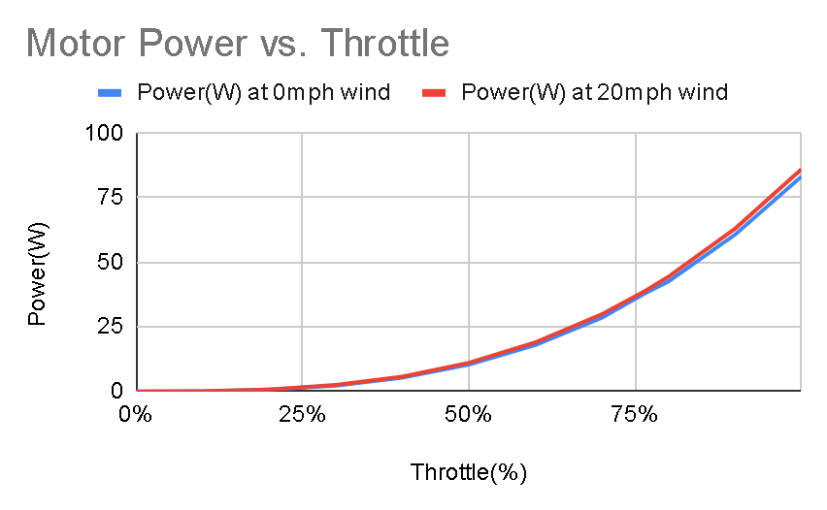
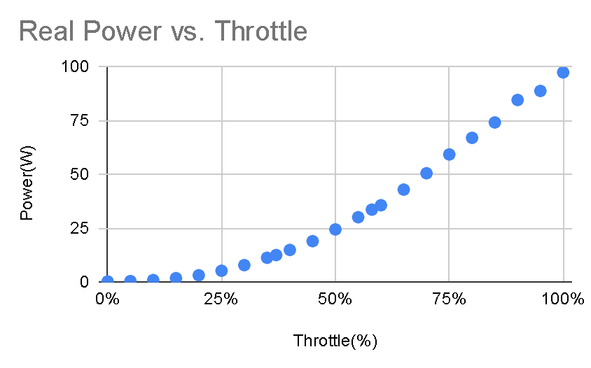
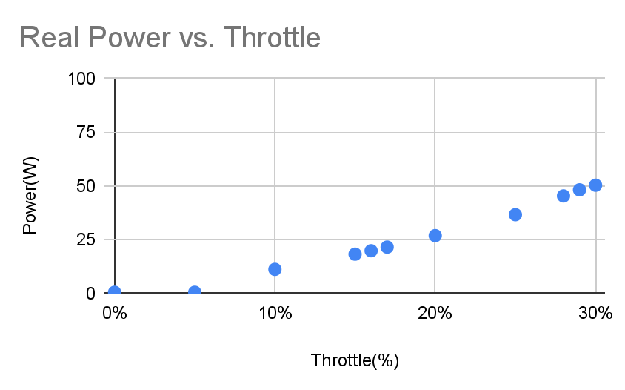
Motor Power Test Results
System Requirement :Drone Flight Time
Results: Original Motors needed lower power than expected from the simulation power curve, while the replacement motors were much more power inefficient de to higher kV rating
Simulated Original Motors without ESCs
Tested Intended 1275kV Motors and 4-in-1 ESC
Tested Replacement 2600kV Motors and 4 single ESCs
77%
2.5N
38-39W
29%
2.51N
48W
58%
2.46N
34W
60%
1.25N
18-19W
37%
1.25N
12.7W
16%
1.225N
20W
Conclusion: Due to the higher Kv rating of the replacement motors, more power was lost to heat trying to turn the propeller, causing more power to be needed for the same amount of thrust and flight time to be reduced. Also, the original motors were more efficient compared to the expected simulation for the same thrust, most likely due to errors in the equation used to calculate initially.
Notes:
Done

Slide 19
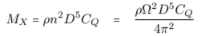
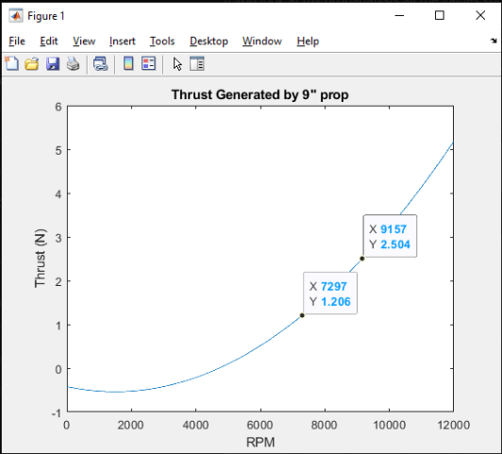
Original Motor Simulation
Hidden slide
Power = Torque(Mx) * Angular Velocity(Ω)
Where
Cq is Propeller Constant, variant on wind speed from .00184-.00190
D = Diameter of propeller .2286m
Ω = Angular Velocity(rad/s), varied from 0-100% throttle, with a max of 11.1V * 1275kV = 1482 rad/s, most likely an error here caused incorrect results
⍴ = Density of Air at 15 C at sea level, simplified to 1.225 (kg/m^3)
77%
2.5N
38-39W
60%
1.25N
18-19W
100%
5.1N
83-86W
Notes:
Done

Slide 20
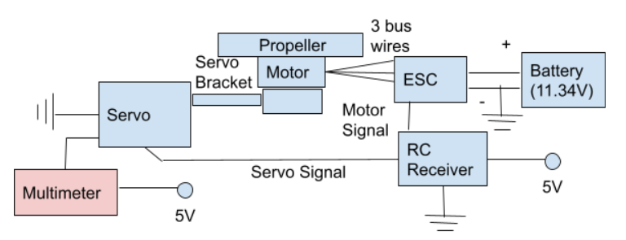
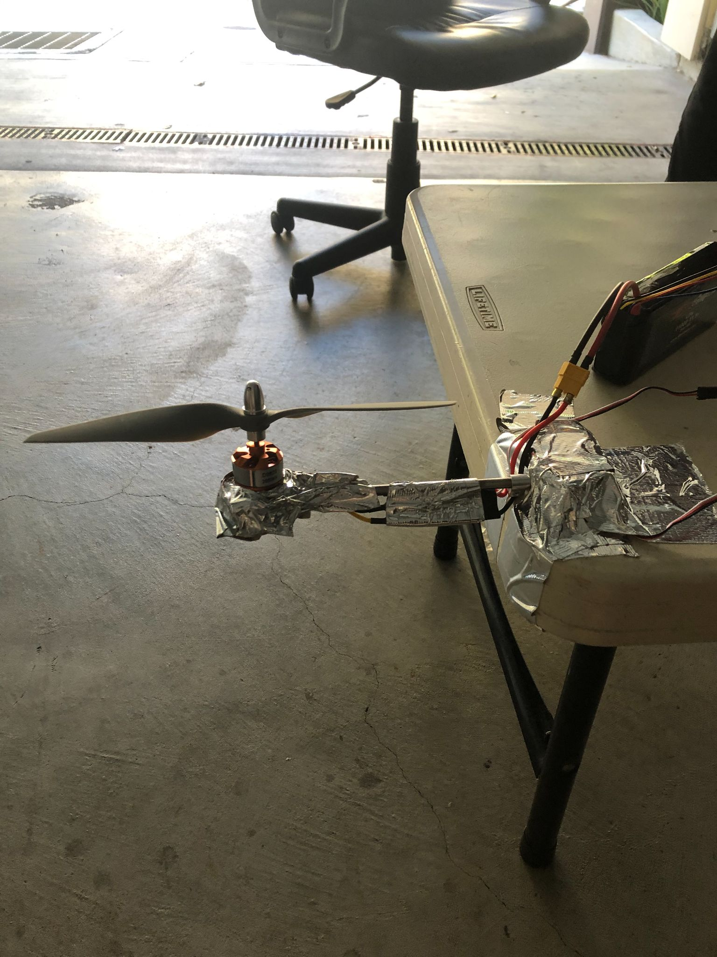
Servo Power Test Was Conducted
Servo Test Block Diagram
Servo Test Setup
System Requirement: Drone Flight Time
Expectation: Servo should not stall under torque of .385Nm from propeller, since servo stall torque is .906Nm
Red = Measurement tool
Blue = System
Procedure:
Tape servo to end of table and screw in servo bracket
Tape motor to end of bracket and connect motor’s 3 inputs to ESC that is powered by the battery
Connect ESC signal and servo signal to RC receiver powered by 5V outlet and with a common ground to the battery
Also power servo through 5V outlet and common ground, but put multimeter in between positive power wire
Run motor at max thrust needed, then turn the servo to see if stall current occurs
Results: Current for Servo varied when moving the servo back and
Forth with motor running with max thrust, but never reached higher than 350mA, which was stated as the max non-stall running current on the datasheet
Notes:
Done

Slide 21
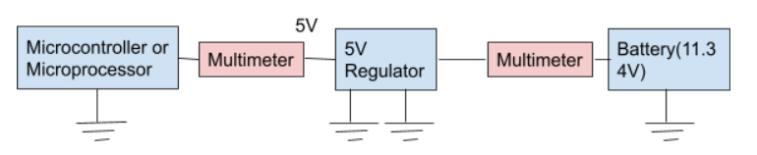
Conducted Microcontroller/Microprocessor and Regulator Power Tests
Microcontroller/Microprocessor and Regulator Test Block Diagram
System Requirement :Drone Flight Time
Red = Measurement tool
Blue = System
Microcontroller:
Expected: 75mA running current from datasheet
Procedure: Will have current tested with multimeter while running code necessary for drone to function with servos and connected sensors
Result: 60mA was needed to run the code while unconnected to other parts
Microprocessor:
Expected less than 1.2A current at 5V, as max current from datasheet
Procedure: Test current with multimeter while running code for sensors
Result: Current while running code for sensors varied 300-500mA, but never reached above 500mA
5V Switching Regulator:
Expected 85% power efficiency from datasheet
Procedure: Test microcontroller current being delivered by regulator and check input current into the regulator to compare power
Result: Battery gave 27mA at 12.2V compared to 60mA needed for microcontroller, only 10% power loss, but when connected to 16V, there was 20mA and 20% power loss. Should Test again using all servos for
better efficiency estimates
Notes:
Redo with 2 tests

Slide 22
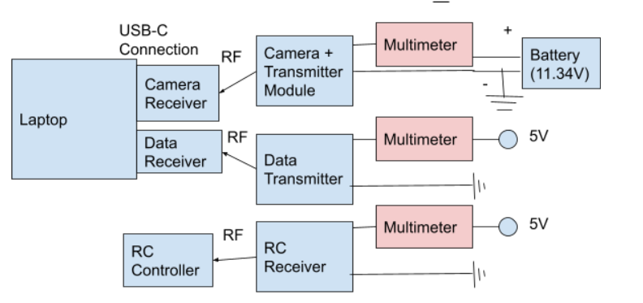
Conducted Transmitters/Receivers Power Tests
Transmitters/Receiver Test Block Diagram
System Requirement :Drone Flight Time
Camera and Transmitter:
Expected: 340mA for both at 11.1V, as shown
by provider
Procedure: Test current needed by camera
module while viewing output on a computer
Result: 305mA when viewing Camera
Red = Measurement tool
Blue = System
RC Receiver:
Expected: Max current as specified by provider is 20mA
Procedure: Ensure receiver is provided 5V with multimeter in the middle to test for current, then
see if moving the joysticks affects the current
Result: Receiver required a constant 34mA, regardless of the actions done on the joysticks
Data Transmitter:
Expected: 100mA at 5V, as shown by provider
Procedure: Connect multimeter in between 5V supply voltage, transmit any signal to computer
Result: Incomplete, Expected 5/29
Notes:
Do 1 tests

Slide 23
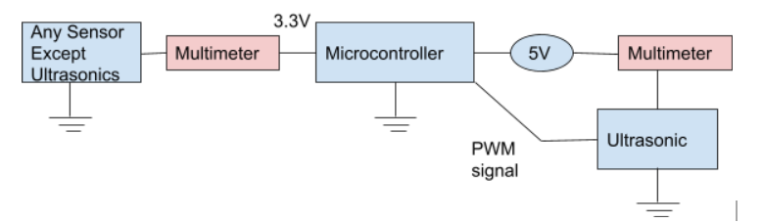
Conducted Sensors Power Tests
Sensors Power Test Block Diagram
System Requirement :Drone Flight Time
Procedures: Current will be tested for the following sensors with a multimeter while they are on and recording data
Altimeter:
Expected .265mA from datasheet
Result: Current was .16mA while working
Ultrasonics:(NY)
Expected 15mA from datasheet,
Must also be given PWM signal for activation
Result: 2mA current needed while ultrasonics were returning values
GPS Module and Antenna:
Expected 25mA for acquisition and 20mA tracking from datasheet
Result: Incomplete, Expected 5/29 only 25mA acquisition current confirmed
IMU:
Expected 3mA from datasheet
Result: Current never went above 3mA max current on datasheet
Pressure Sensor:
Expected 4mA from datasheet
Result: Incomplete, Expected 5/29
Red = Measurement tool
Blue = System
Notes:
Do 4 tests

Slide 24
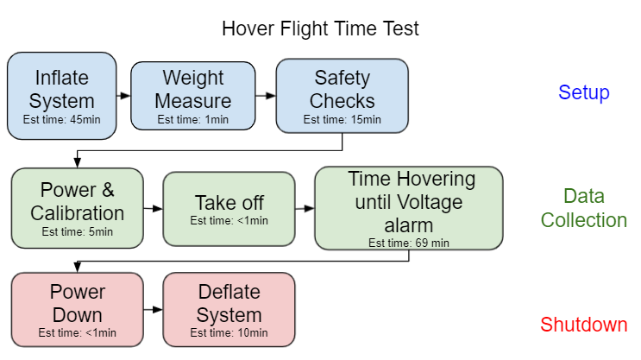
Procedures of Hover Time Test
System Requirement :Drone Flight Time
Expectation: System should hover for 69 Minutes, provided inflated system weight & motor thrust are correct
A flight test to determine the hovering time of the system was attempted with the following procedure
Flow chart representation of the hovering flight time test, broken into three phases. Each box represents a high level step in the procedure
Note: This test will also be used to find inflated system weight which is expected to be between 0&5N

Slide 25
Detailed Future Flight Tests Procedures
Hidden slide
System Requirement :Drone Flight Time
Procedure:
Layout envelope so that all brackets are on outskirts.
Inflation
Since envelope is large then anticipated first the lift bag will be inflated until it is sphere with 1.5m diameter or 1.8m³ in volume
The rest of of the system will be filled with 4m³ of helium
Check weight of system
Safety Check
Assure that all attachments are securely
Attach tether to weight on ground
Power and calibration
If uncalibrated
Follow calibration steps
If calibrated
Turn power on
Flight test (timed portion)
Servos to upright position
Throttle to 29% (max thrust) to get system off the ground
Reduce throttle to 16% for hovering
Keep hovering until voltage alarm sounds
Reduce throttle to 0%
Turn off power switch
Deflate system
Calibration Steps
Set throttle curve to max at 100%
Throttle to 100% with system off
Turn system on
Wait for 2 beeps followed by third beep
Turn throttle to 0% within 2 seconds
Wait for 3 more beeps
Set throttle curved to max at 29%

Slide 26
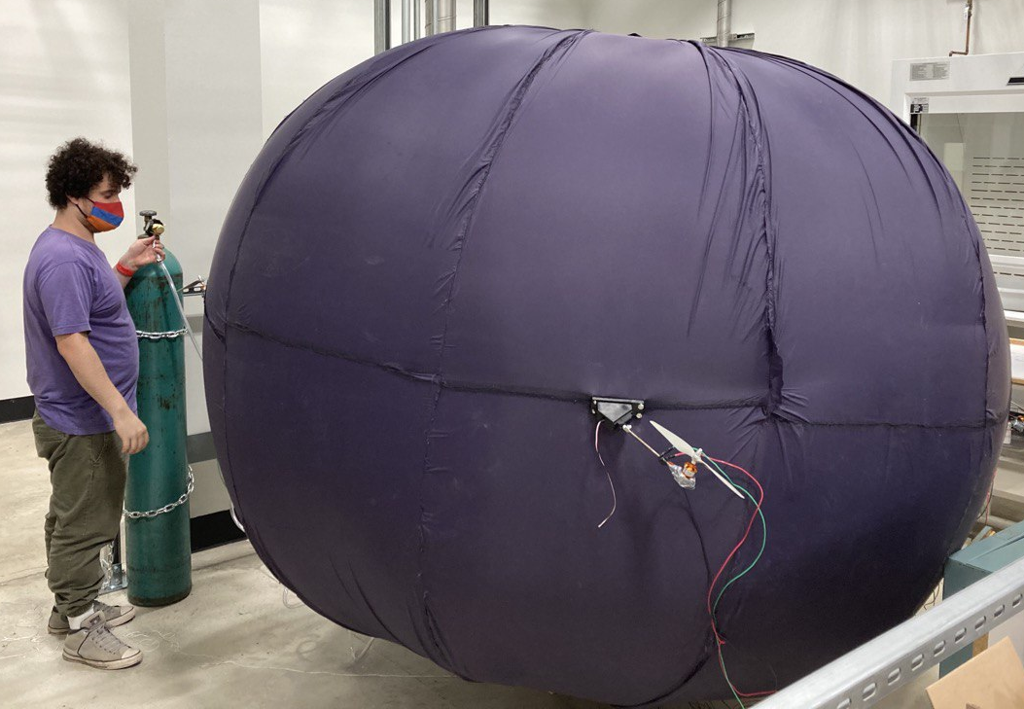
Results of Failed Flight Time Test
System Requirement :Drone Flight Time
The Hover test was attempted twice but failed to achieve lift off either time.
Attempt 1
Fully inflated to full sizes with motors held taught and outright
Weight of system was too high (1.3kg) due to over compensation of air for excess envelope volume
Safety checks for wiring, attached parts and tether connection where completed
System was punctured in transport from fabrication room to flight room.
Attempt 2
The inflation was done inside the flight room to avoid transportation accidents
Tube connection error caused helium loss during inflation process
Not enough helium was left to fully inflate the system and the motor mounts were not held taught
In this test the helium air ratio was also corrected, however due to the helium leak the final system weight was still too high at 798g.
Due to slack on motor mounts servo shaft would swing into envelope before providing enough lift to be airborne
Second lift bag was punctured when attempting to add extra air to remove slack
Attempt 1: Fully Inflated System
Attempt 2: Takeoff attempt
Conclusion: If the helium leak had not caused slack in the envelope the system would have likely been able to hover, however the time of hovering cannot be determined from these results. So Power Testing remains our best flight time estimate.

Slide 27
Drone Effective Weight Measured During Hover Test
System Requirement :Drone Flight Time
Requirement The drone shall have an effective weight of between 0 and 5 N When inflated.
System weight needed to be determined to confirm throttle values for hovering
 | Requirement(N) | Measured (g) | Measured (N)
System without helium | 40-45 | 4444 | 43.58
System with Helium | 0-5 | 798 (From incomplete inflation) | <7.83 (From incomplete inflation)
Conclusion: The drones effective weight is within the expected range when uninflated. Inflated Weight was too high due to Helium leak during inflation

Slide 28
Remote Control Verified in Matlab, with Plans for Detailed Vrep Simulation Test
Matlab Verified
The drone shall have RC control implementation to allow for direct control of the drone, and maintain pitch and roll angles within ±0.1 rad, and a height of 1±0.15 m. The drone shall move at the minimum speed.
Angle Correction Verified in Matlab
Closed Loop RC Commands Verified in Matlab
Flight Layout in Vrep is given to provide a detailed Vrep Simulation
Conclusion: The remote control functionality is not yet verified in the Vrep simulation environment.

Slide 29
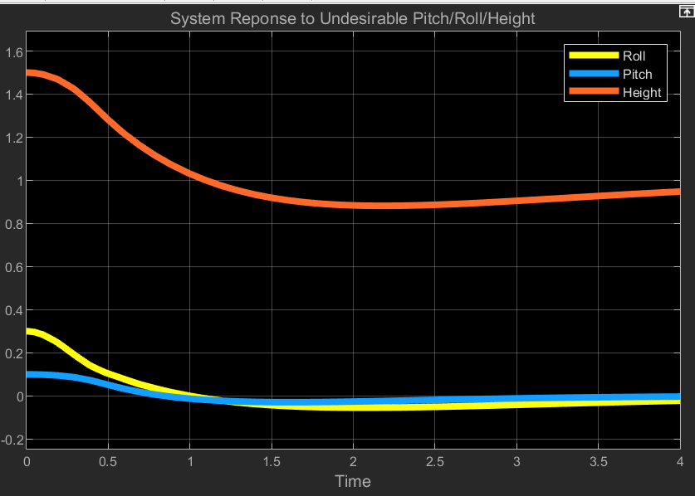
Closed Loop RC Angle Correction Verified in Matlab
System Requirement :Remote Control
Requirement: The system should return pitch and roll to an error of less than 0.1 radians and a height error of <15% in less than 1 second.
In this example, the height barely meets the overshoot requirement, but that slow response is partially due to large roll error.
Conclusion. Even with large errors, 0.5 meters and 0.3 radians, the system is able to return to stable conditions, but needs to be re-tuned for new specifications.
Fig. System Pitch/Roll/Height Response, with saturation block connected

Slide 30
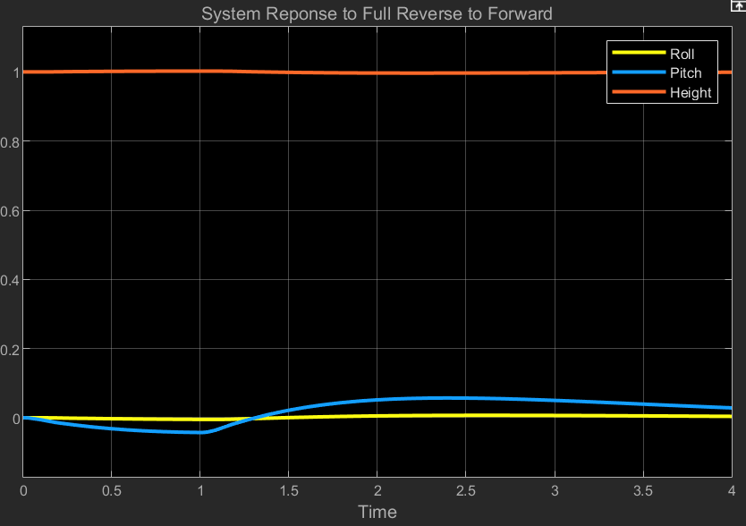
Closed Loop RC Worst Case Command Response Stable, Verified in MatLab
System Requirement :Remote Control
Task: Ensure the Regulator is able to maintain pitch and roll angles within ±0.1 rad, and a height of 1±0.15 m. when given RC commands.
The worst case scenario for RC commands is going from full reverse to full forward. Max pitch overshoot is about 0.06 radians, within the 0.1 radian limit.
Conclusion: The closed loop RC design is stable and ready to be imported into Vrep
Fig. System response when switching from full reverse to full forward at t = 1 second

Slide 31
Closed Loop Remote Control Not Verified
System Requirement :Remote Control
Expectation: The drone will conduct a simulated flight through simple functions and maintain pitch and roll angles within ±0.1 rad, and a height of 1±0.15 m while reaching a speed of at least 5 mph.
Closed Loop Remote Control Vrep Test V 1.0
Auto Take-off
Forward 10s
Change of Terrain Height
Turn Command 5s
Forward to Backwards Test
Auto Landing
Each Block tests essential functions of the Remote Control system, as well as the worst case user input, full forward to full stop.
This test will be performed with no wind, steady wind, and with unsteady wind to confirm stability, but has not yet been conducted.

Slide 32
Autonomous Control Design Incomplete
Not Verified
Requirement: The drone shall be able to follow a predetermined path in order to collect data, while maintaining pitch and roll angles within ±0.1 rad, and a height of 1±0.15 m.
The Drones Autonomous Control system design was not completed, and therefore cannot be verified.
Various parts were selected that would interface with the autonomous control system and tests to verify these parts are addressed in the following slides
Autonomous Control Vrep Test V 1.0
Auto Take-off
Move to Waypoint A
Begin movement to Waypoint B
Change Terrain Height
Move to Waypoint C
Auto Landing
This test would be conducted with no wind, steady wind, and unsteady wind to test system stability, but has not yet been tested.

Slide 33
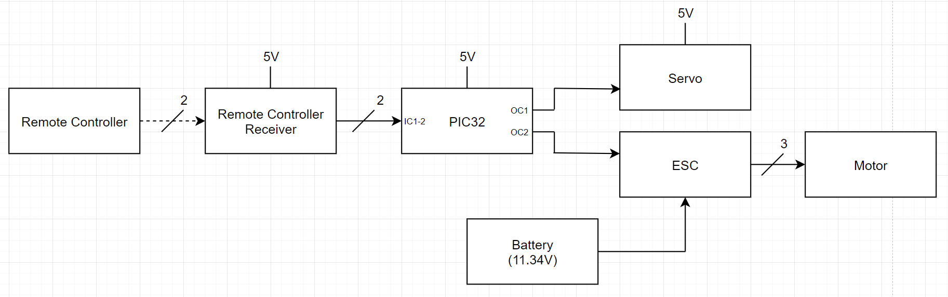
PIC32 Reads in RC Inputs from RC Receiver and Moves Servos and Motors
System Requirement: RC & Autonomous Control
Expectation: PIC32 should read in remote controller inputs (throttle, yaw, pitch, roll) from remote controller receiver and move several servos and motors independently of each other
Results: PIC32 currently changes a single servo’s angle and a single motor’s speed based on remote controller throttle and pitch inputs
Verification:
Conclusion: PIC32 currently only moves one servo and motor using two inputs from the remote controller, but will need to move all four servos and motors using four inputs from the remote controller in order to meet the requirement
Remote controller moving servo and motor demo
Remote controller moving servo and motor block diagram

Slide 34
Actuator Selections
Hidden slide
Component Requirement: RC & Autonomous Control
Servo
Requirements:
Stall torque > 0.143NM
Positional data
>360°
Selection: SW5513-6MA Winch servo
Motor
Requirements:
RPM>7300
Can spin 10g load under stall current
Selection: FLASH HOBBY D2822 Brushless Motor 2600KV
ESC
Requirements:
30A
Selection: Hobbypower SimonK 30A ESC

Slide 35
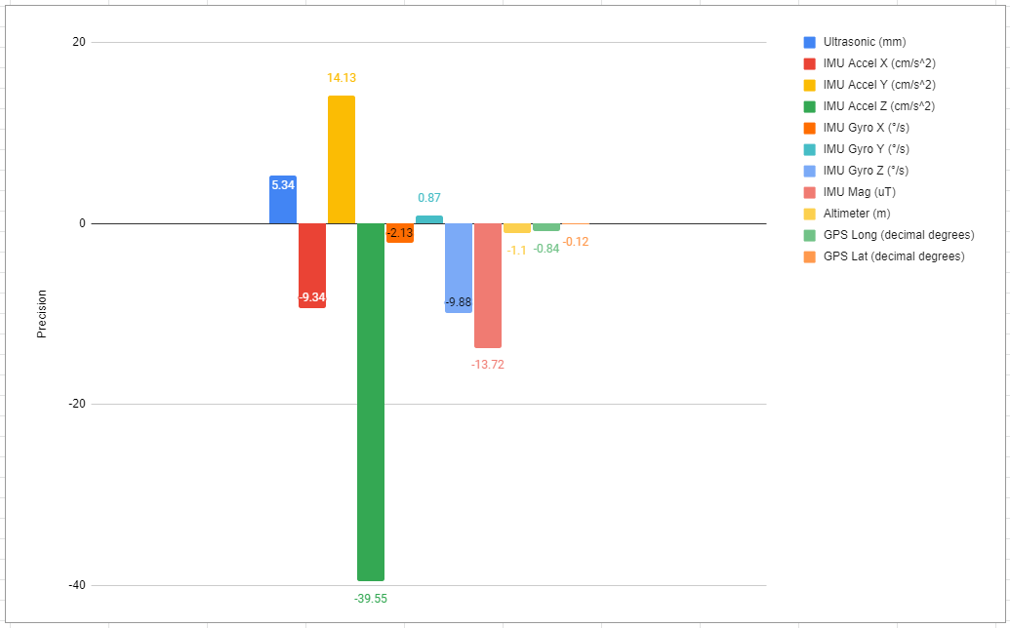
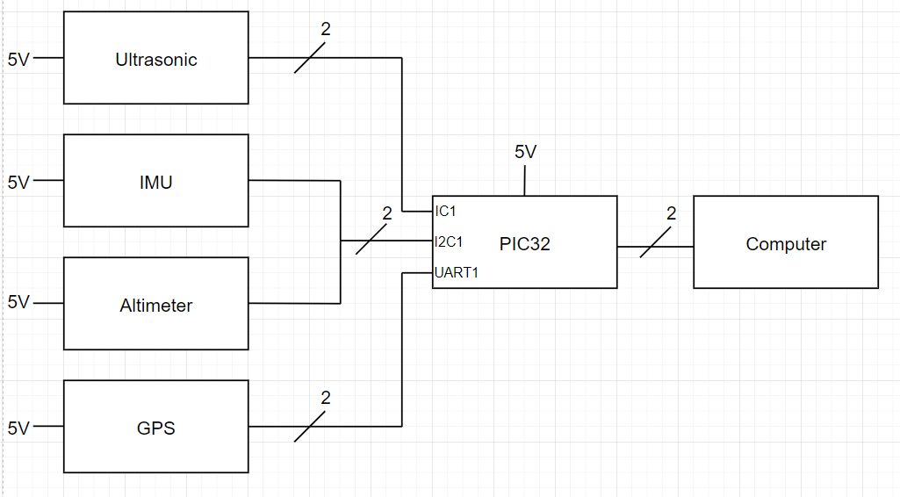
PIC32 Reads from Several Sensors
System Requirement: RC & Autonomous Control
Expectation: PIC32 should read from ultrasonic, IMU, altimeter, GPS, and air pressure sensors with precision from the respective datasheets
Results: PIC32 currently only reads from the ultrasonic, IMU, altimeter, and GPS sensors, and only the GPS sensor doesn’t meet our requirements of being within 5m precision, as well as not having the air pressure sensor implemented yet
Verification:
Conclusion: The ultrasonic, IMU, and altimeter perform within our requirements, but the GPS is still more than 300 meters away from its expected position. To meet this requirement, further testing and debugging needs to be done with the GPS
All sensors working block diagram
Average precision (actual value - measured value) of sensors over 10 seconds (GPS is over 90 seconds)

Slide 36
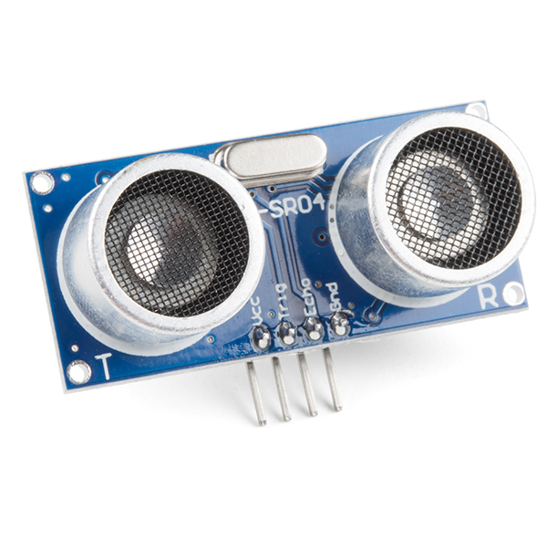
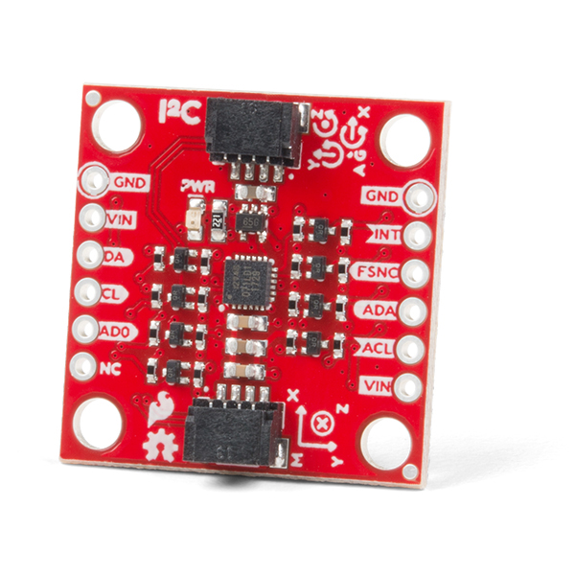
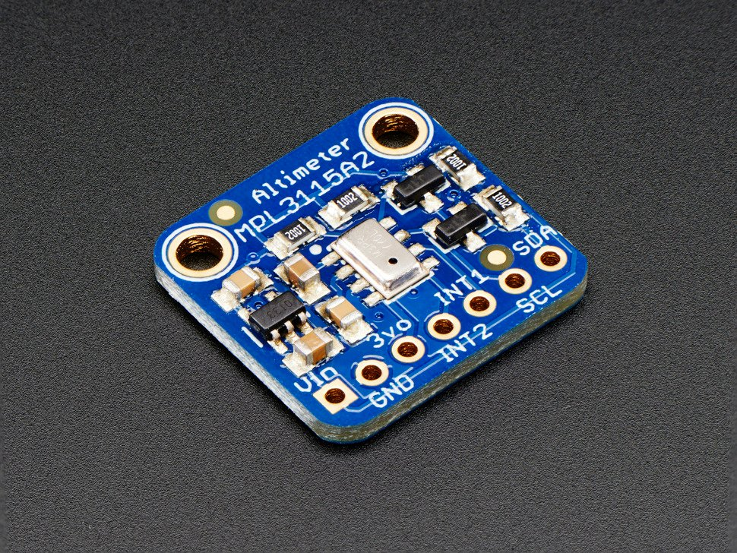
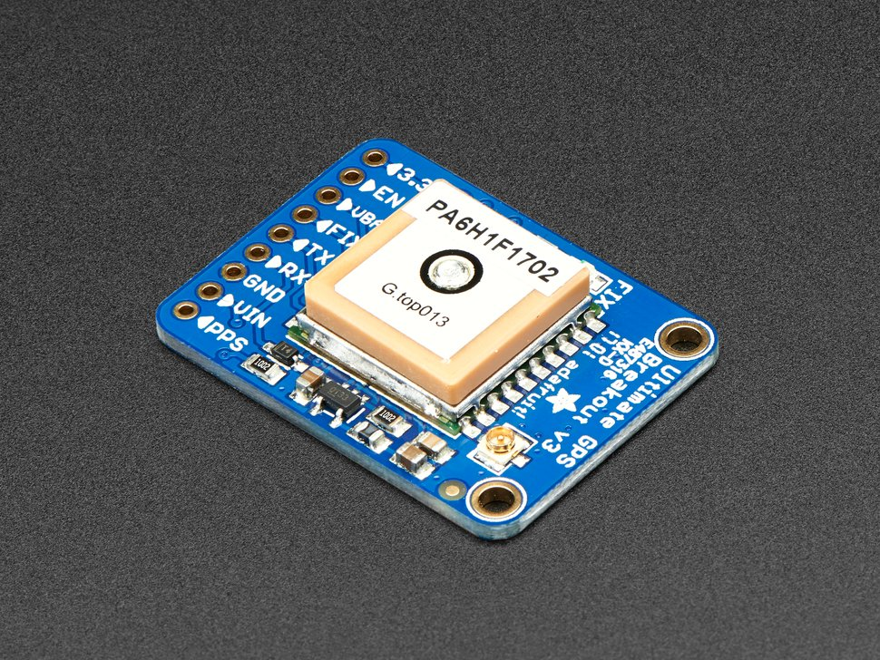
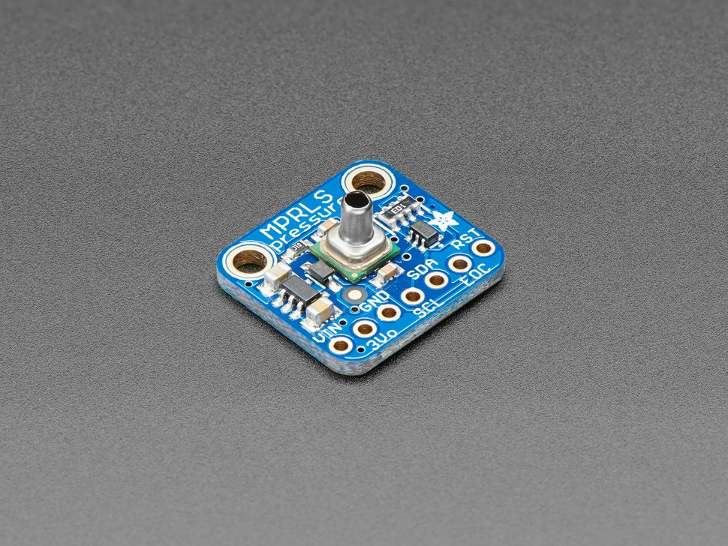
Sensor Selections
Hidden slide
Component Requirement: RC & Autonomous Control
Ultrasonic:
Requirement: Must measure distance from drone within 1m
Sensor chosen: HC-SR04 - Accuracy of 3mm
IMU:
Requirement: Must measure orientation of drone (yaw, pitch, roll)
Sensor chosen: ICM-20948
Altimeter:
Requirement: Must measure altitude of drone within 1m
Sensor chosen: MPL3115A2 - Accuracy of 0.3m
GPS:
Requirement: Must measure GPS location of drone within 5m
Sensor chosen: MTK3339 - Accuracy of 3m
Air pressure:
Requirement: Must be able to detect loss of helium in drone lift bag
Sensor chosen: MPRLS
Notes:
IMU percentage of error needed for controls to remain stable
Air pressure sensor needs to measure up to max PSI

Slide 37
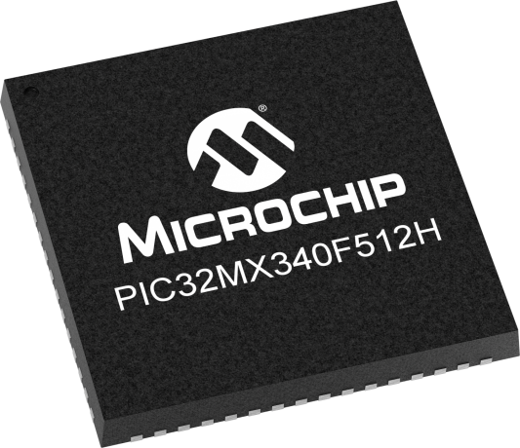
Microcontroller Selection
Hidden slide
Component Requirement: RC & Autonomous Control
Device interfacing required for microcontroller:
Raspberry Pi - SPI
Sensors:
IMU - I2C
Ultrasonic - 4 Input Captures
Altimeter - I2C
GPS - UART
Air pressure - I2C
4 Servos - 4 Timers
4 Motors - 4 Output Compares
Computer debugging - UART
In total, 1 SPI module, 1 I2C module, 2 UART modules, 4 Input Captures, and 4 Output Compares are needed from the microcontroller
Microcontroller chosen - PIC32MX340F512H:
2 SPI
2 I2C
2 UART
5 Input Captures
5 Timers
5 Output Compares
Conclusion: PIC32MX340F512H had more than enough hardware required for all device interfacing, and could be used with the MPLABX IDE to interact with its lower-level hardware.

Slide 38
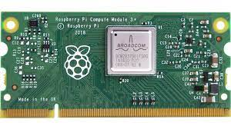
Microprocessor Selection
Hidden slide
Component Requirement: RC & Autonomous Control
Device interfacing required for microprocessor:
PIC32 - SPI
Data Telemetry Transmitter - UART
Computer - UART
In total, 1 SPI module and 2 UART modules are needed from the microprocessor
Microprocessor chosen - Raspberry Pi Compute Module 3+:
2 SPI
2 UART
Conclusion: The Raspberry Pi had enough hardware required for all device interfacing, and had an SD card module on board in order to store data over time if needed

Slide 39
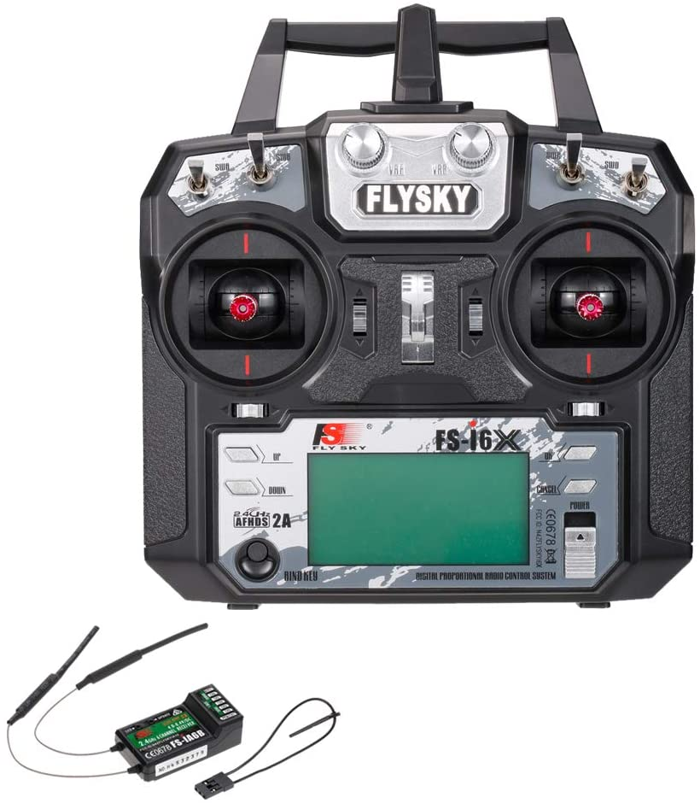
Remote Controller and Receiver Selection
Hidden slide
Component Requirement: RC Control
Requirement: Remote controller must send throttle, yaw, pitch, roll, and button/switch commands (6 channels) to receiver and receiver must be compatible with PIC32
Results: Flysky FS-i6X and Flysky FS-iA6B were chosen
Flysky FS-i6X:
10-channel remote controller
Flysky FS-iA6B:
6-channel receiver
Plugs into PIC32 or Raspberry Pi with jumper wires

Slide 40
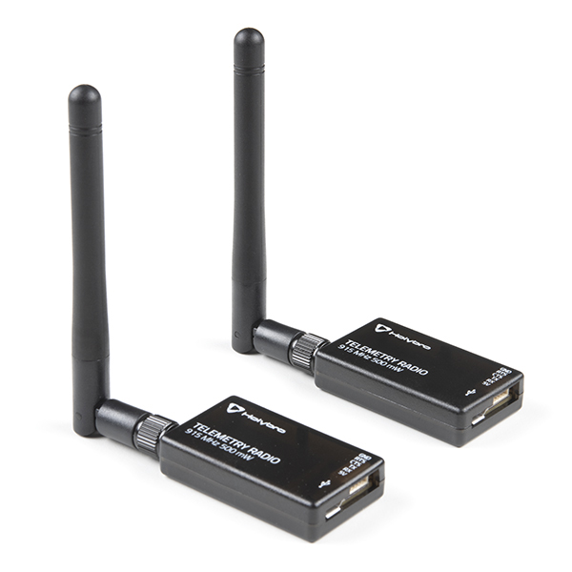
Telemetry Radio Transmitter and Receiver
Hidden slide
Component Requirement: RC & Autonomous Control
Requirement: Data telemetry must be sent from drone back to user on the ground. Telemetry transmitter on drone must be compatible with Raspberry Pi and telemetry receiver on ground must plug into computer
Results: Holybro Telemetry Radio was chosen
Holybro Telemetry Radio:
Transmitter plugs into Raspberry Pi via UART
Receiver plugs into computer via USB

Slide 41
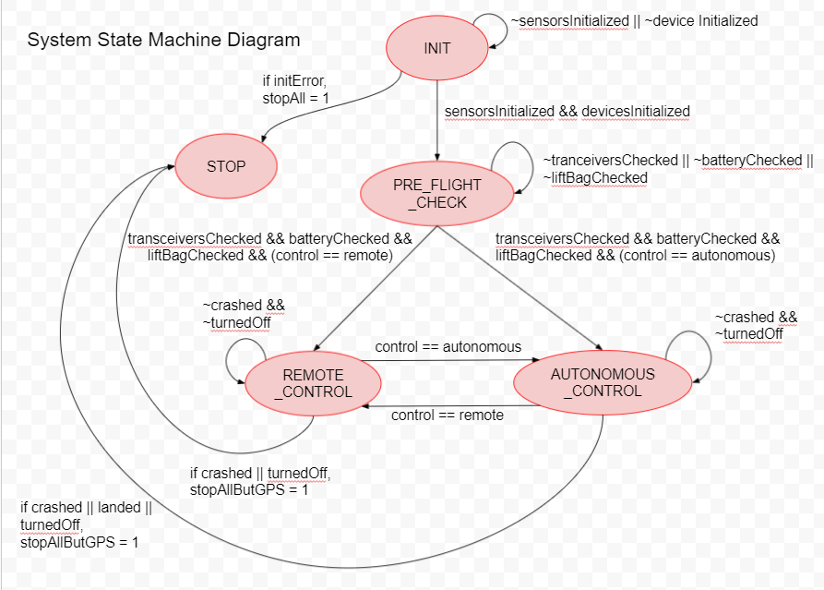
System State Machine Designed But Not Implemented
System Requirement: RC & Autonomous Control
Expectation: System should include start-up procedure, error checking, and systems communication
Results: The state machine has not been written in code and tested yet because of delays with configuring and wiring the servos/motors; only a state machine diagram has been made:
Conclusion: To meet this requirement, we would need to implement this in code, starting by first integrating remote control into the state machine and testing and then adding in autonomous control afterwards

Slide 42
Manufacturability of System Was Not Verified
Not Verified
Requirement: The drone should be able to be manufactured with equipment within our workspace
This requirement was not met
Envelope: Cut and sewn from nylon sheets | Needs Adjustment
Electronics Brackets: 3D printed | Successful
Mounting plates: 3D printed | Successful
Gondola: 3D Printed | Successful
Actuators: Mounted to envelope | Successful
PCB: Soldering | Failed
Envelope was manufactured but the shape could not be correctly adjusted.
V1.9 PCB Manufacturing failed due to incorrect footprint and trace width sizes, however with the correct tools and precision it is possible for hardware to be soldered.
Conclusion: All parts related to the frame of the drone have been manufactured using available equipment. The PCB was not properly manufactured, but it can be with slight adjustments.

Slide 43
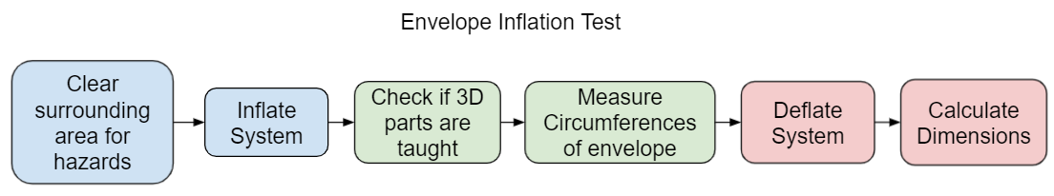
Envelope Shape Test Process
System Requirement: Manufactuability
Goal: The dimensions should be 108”x 108”x40” (width and height diameters) & holds servo brackets taught
Expectation: The dimensions will be more spherical than expected, since more width was lost in the sewing process. The brackets holding the servos and propellers are expected to be held taught once the envelope is fully inflated.
Several envelope inflation tests were conducted with the following procedures

Slide 44
Detailed Envelope Inflation Procedure
Hidden slide
Procedure:
Clear area of hazards
Layout uninflated envelope flat
Inflate Lift Bag inside envelope using shop vacuum
Adjustments of how the envelope is resting on the lift bag needs to be made during inflation so that 3D parts do not hit the lift bag at a strange angle.
The opening of the balloon should also be kept center as it naturally wants to rotate
Tie off balloon mouth with rubber bands
3D parts are checked to be held thought
Measure horizontal and vertical circumference of the fully inflated envelope to calculate dimensions

Slide 45
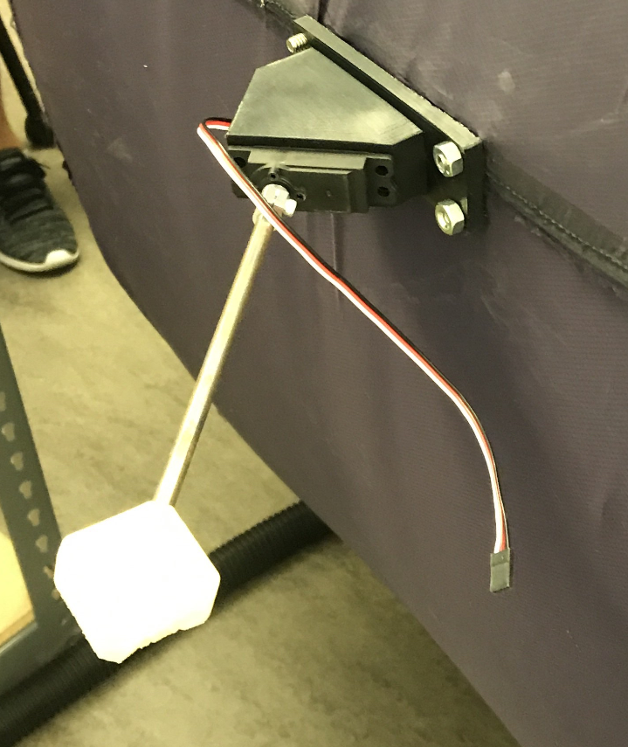
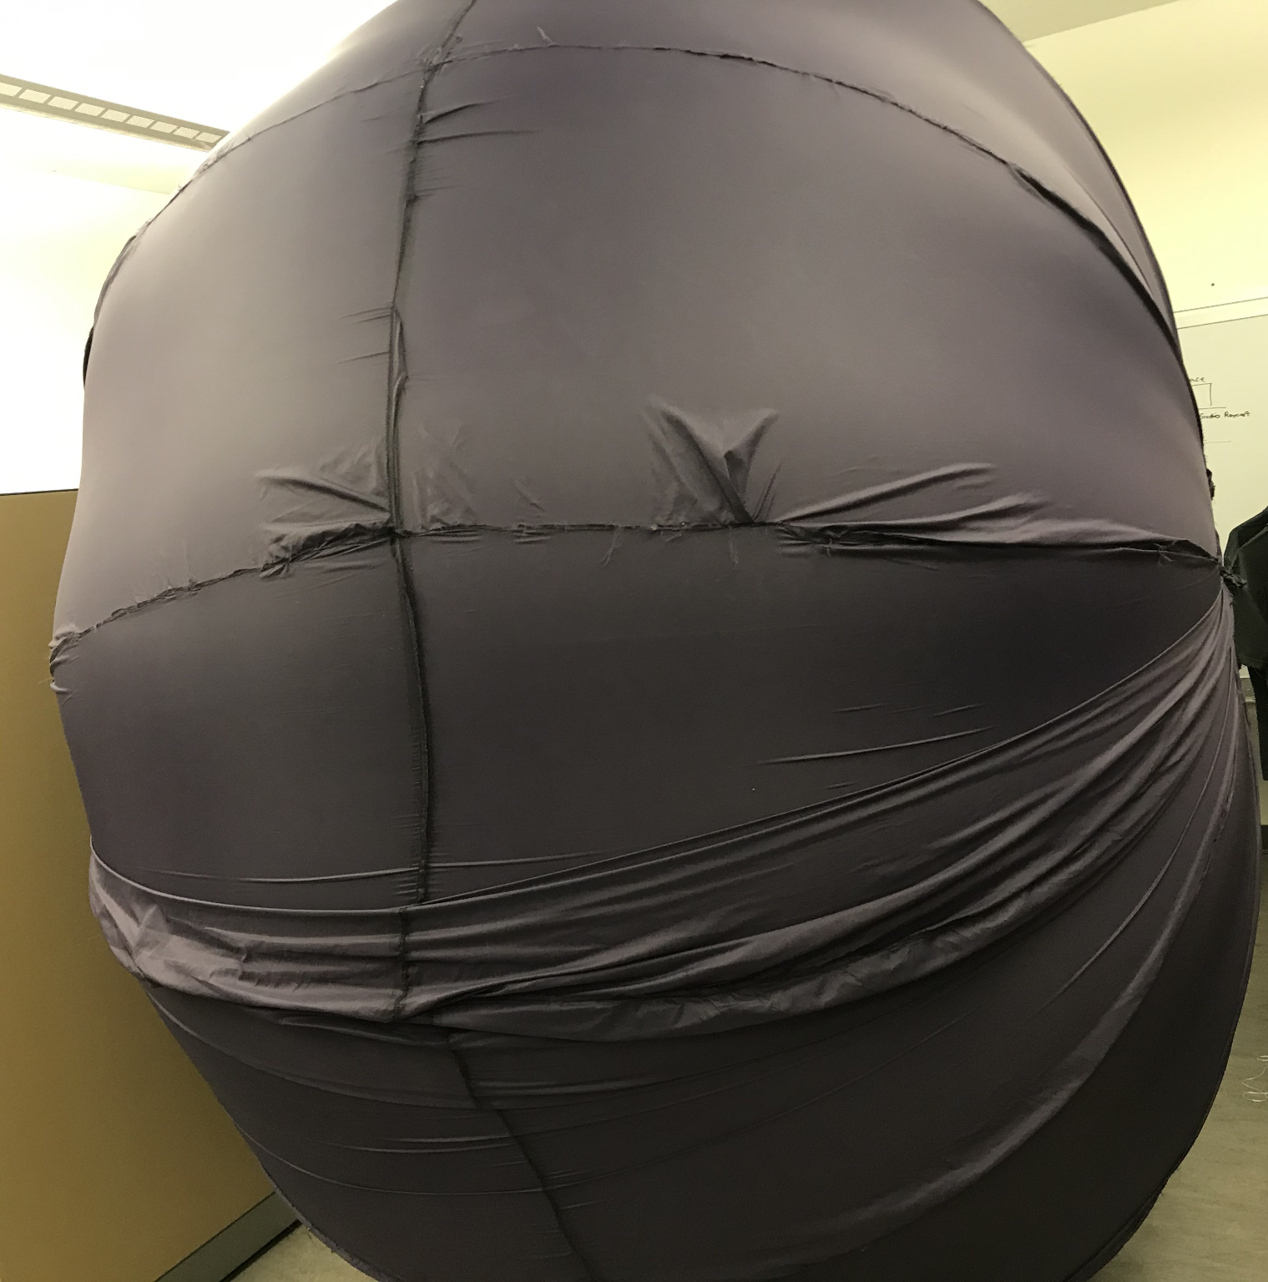
Results of Envelope Shape Test
System Requirement: Manufactuability
Specs of significant envelope versions
102”
Version | Circumferences | Diameters
Goal | 255” & 339” | 108x108x40”
V1 | 284” & 309” | 98.4x98.4x81.7”
V5 | 269” & 308” | 98x98x71.1”
V7 | 276” & 322” | 102x102x70”
69”
Envelope shape after final inflation test
Servo shaft held taught during inflation test
Conclusion: The Envelopes best dimensions were 102”x102”x69” which does not meet the requirement.
a new envelope would have to be fabricated in order to further correct the shape, further the lift bag naturally wants to take the shape of a sphere which causes its to apply a large amount of force capable of breaking poorly done stitching.
Fabrication of an envelope using nylon and stitching has been proven plausible but has obstacles that still need to be overcome.

Slide 46
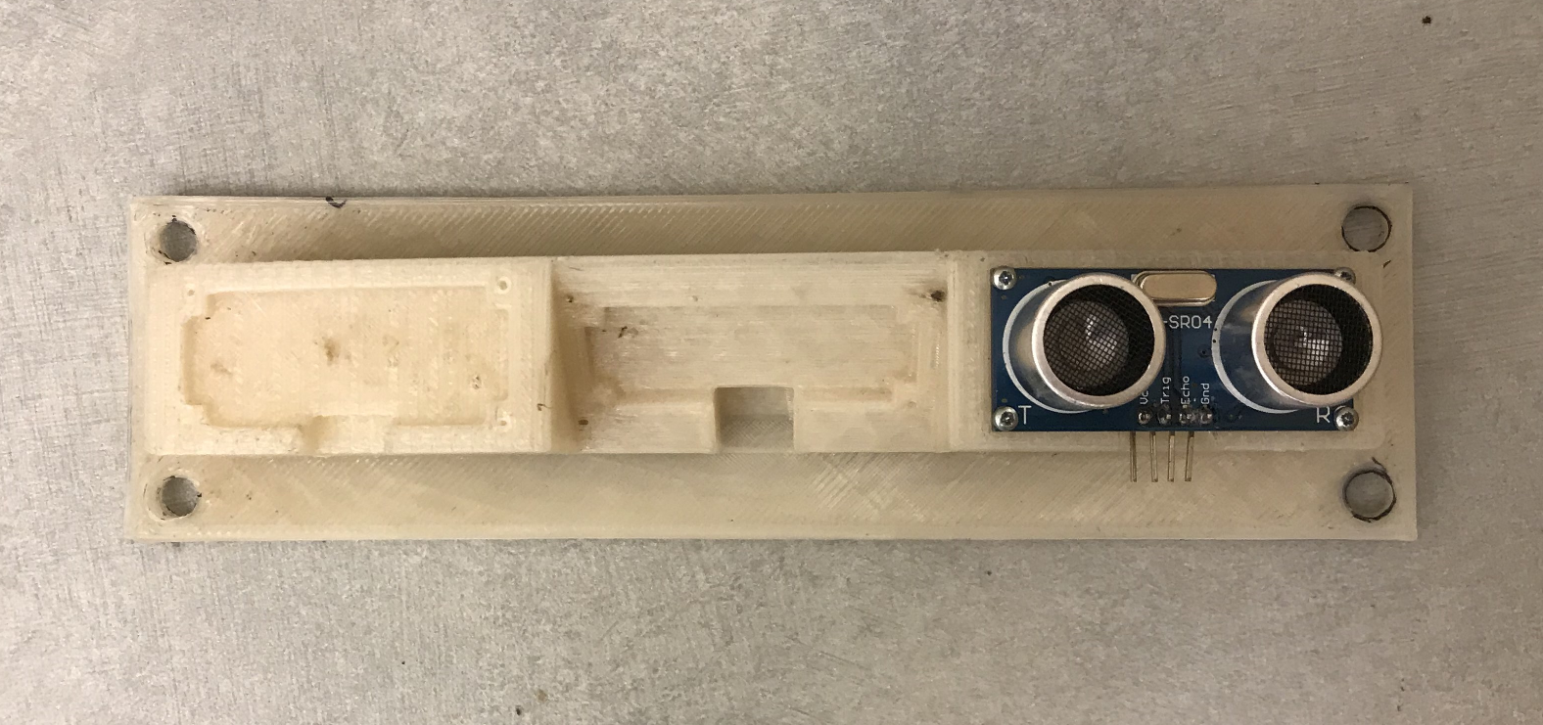
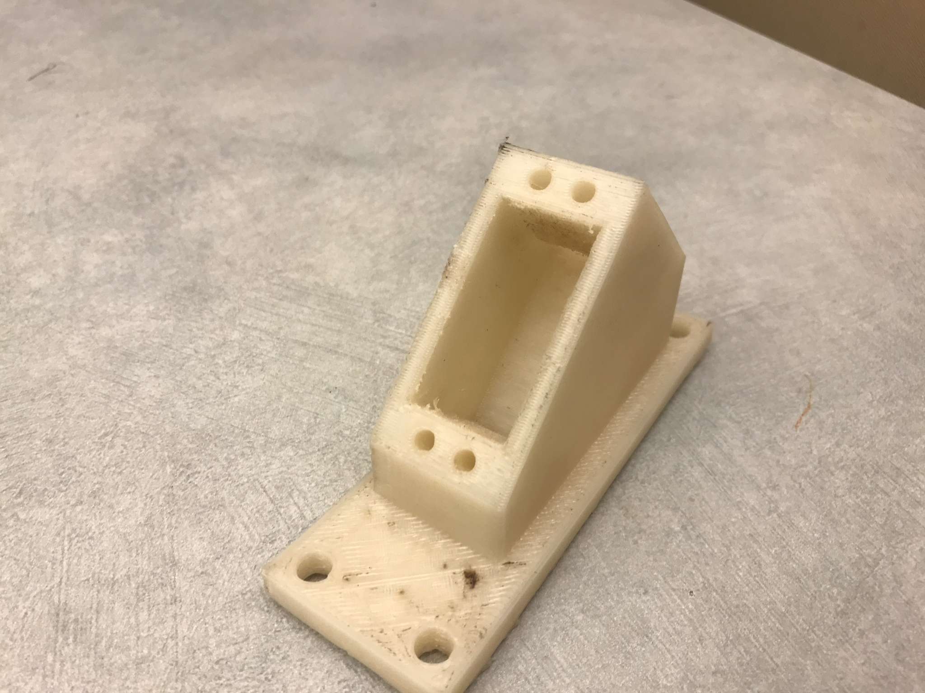
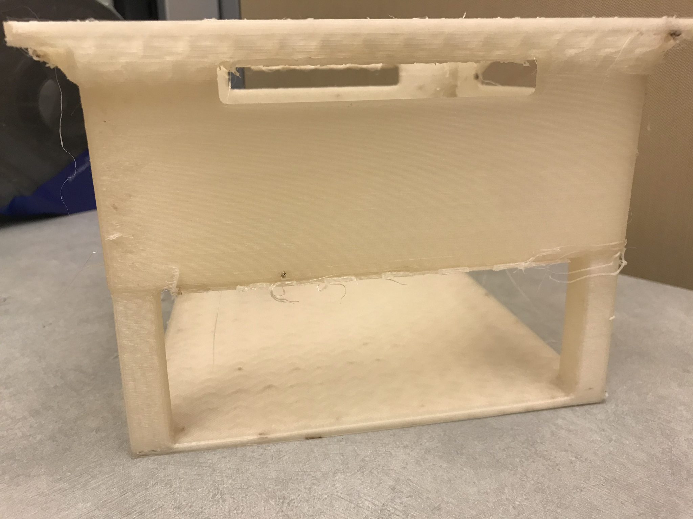
Results of 3D printing
Hidden slide
System Requirement: Manufactuability
Requirements: 3D printed parts must hold specified electronic components
9mm
22mm
46mm
4.2mm
59mm
29mm
60mm
Ultrasonic mount measured with calipers
155mm
Servo Bracket
measured with calipers
Gondola
measured with rulers
Conclusion: all 3d Printed parts meet size specifications and weight specifications, held relevant parts, and all parts survived testing.

Slide 47
Drone PCB Board Design Goals not Implemented
System Requirement: Manufactuability
Requirement: Drone sensor array and all breakout component wiring points shall fit within the frame size
Goals:
4” x 4” PCB size fits within the drone’s gondola
Actuators, voltage regulators, and ultrasonic sensors have through hole soldering points to the PCB
On-board sensor array includes IMU, Altimeter, GPS module, and balloon pressure sensor
PIC32 microcontroller for sensor array data collection and actuator output soldered on PCB
Raspberry Pi microprocessor for state machine estimation plugged in via soldered DDR2 SO-DIMM slot
Conclusion: PCB V1.9 was not implemented in the gondola due to incorrect footprints and trace width too small. Breakout boards and dev boards were used instead but the same sensors, microcontroller, and microprocessor were used. PCB V2.0 can be manufactured with 1812 SMD footprint, verified parts dimension on retail site, and PCB leader in U.S. to solder in person.

Slide 48
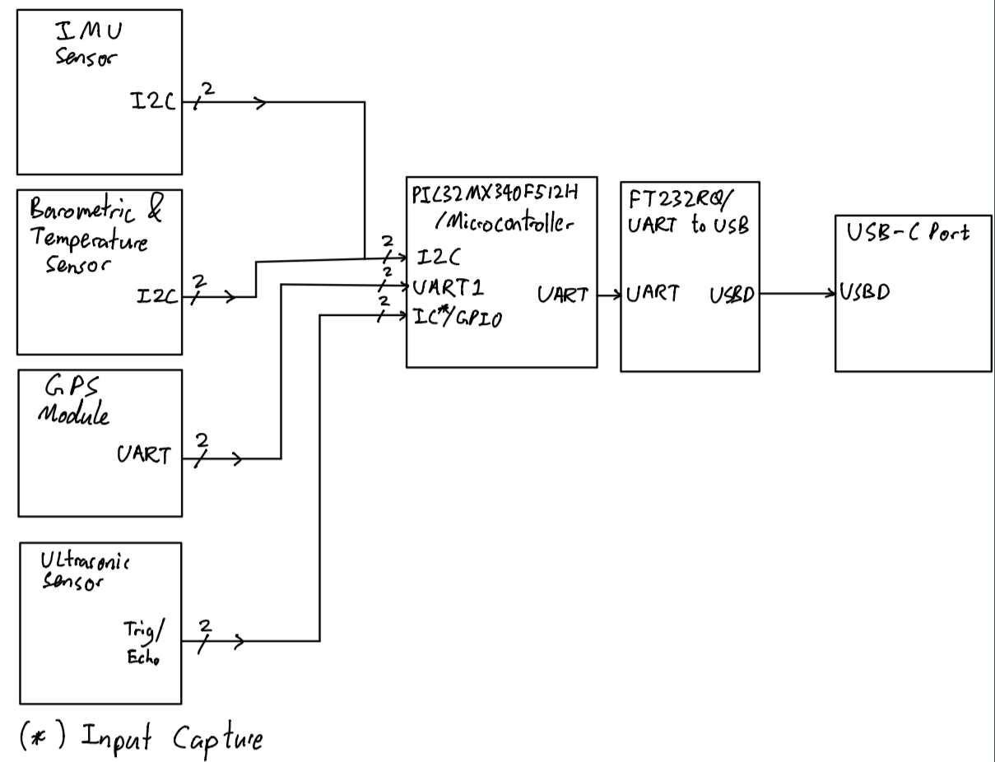
PCB Sensor Array Verification Method
System Requirement: Manufacturability
Expectation: Sensor array data should be able to be displayed to a computer monitor
Procedure:
Plug in The USB-C header to a PC
Plug in the 12V lipo battery to the PCB
Open the PuTTY terminal
Set the PCB on the table
Verify GPS longitude data matches to Google maps location
Verify barometric sensor matches to 1atm at sea level
Verify the IMU accelerometer data matches 9.8m/s^2 in one axis and the rest are 0m/s^2
Move a flat surface towards the ultrasonic sensor and verify the distance with a ruler
Block diagram for sensor array debugging
Notes:
Sensor Array Debugging (altimeter, IMU, GPS, barometric sensor)
Debug via UART from PIC32 microcontroller to FT232 UART to USB Protocol using PuTTY
Second UART pins from PIC32 allocated for sensor data printouts

Slide 49
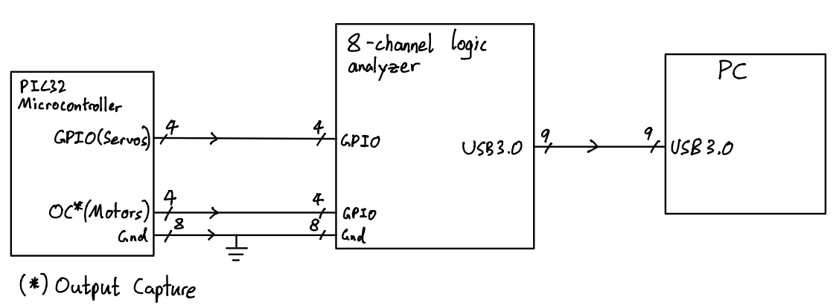
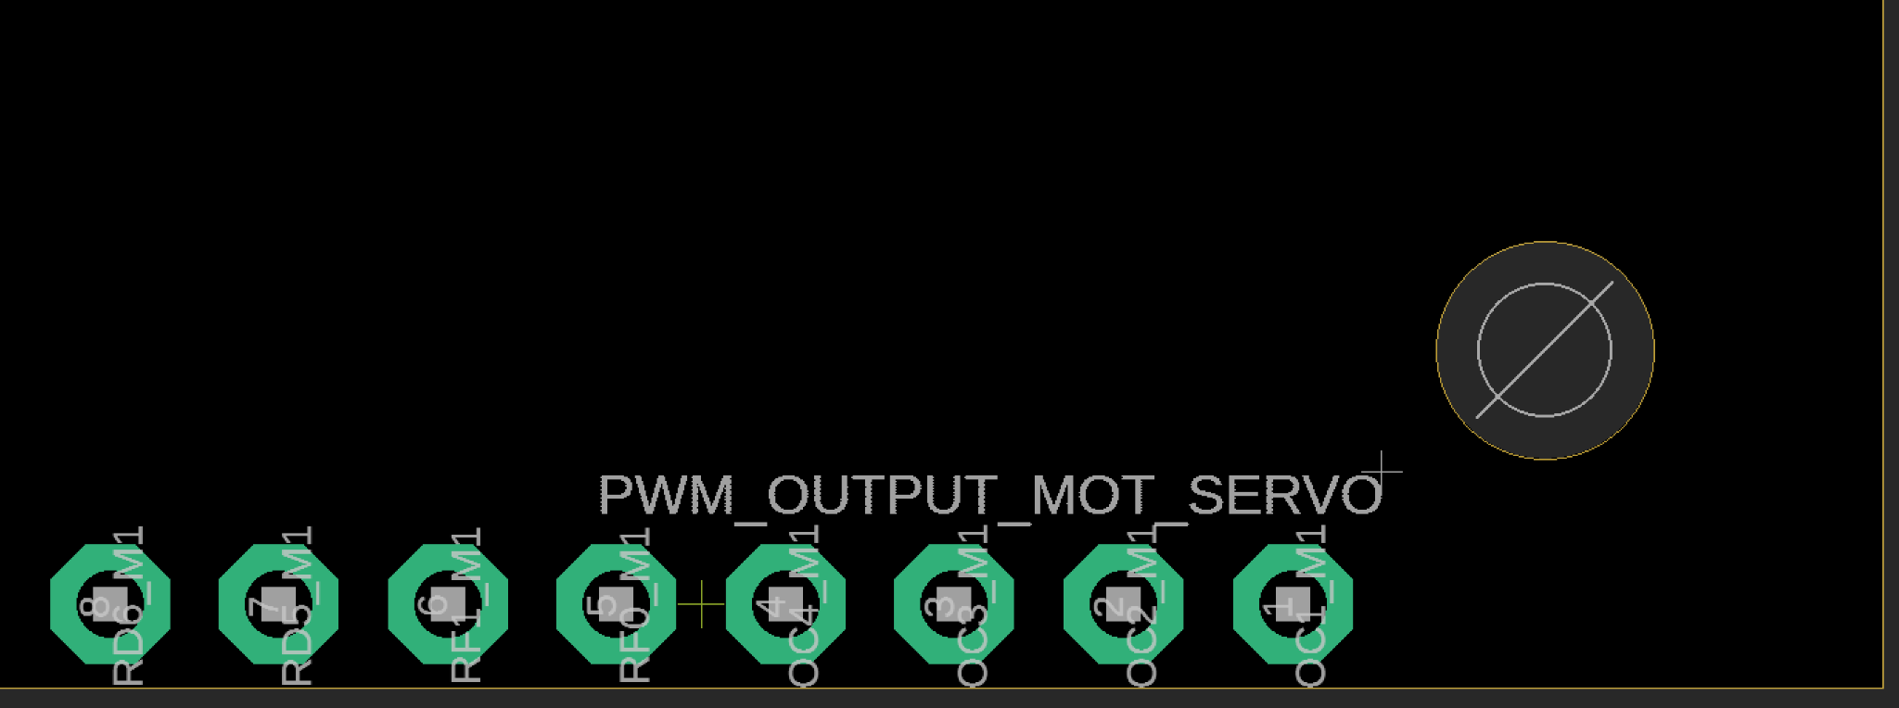
PCB Actuator Verification Method
System Requirement: Manufactuability
Expectation: Verify servo and motor PWM signal from PIC32 microcontroller
4x Servo PWM signal
4x motor PWM signal
Probe each of the through hole pins to measure PWM output signal from microcontroller
Located on PCB
Block diagram for actuator PWM debugging

Slide 50
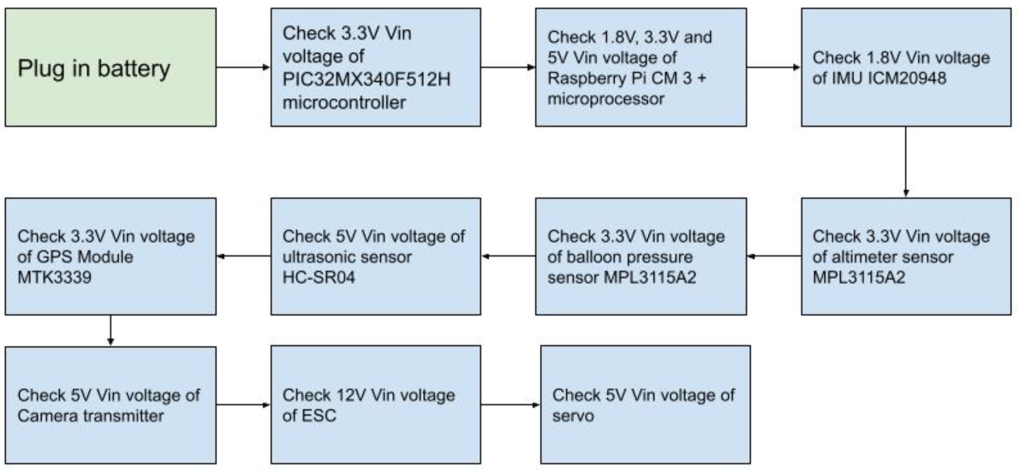
PCB Power System Verification Implementation
Expectation: All electronics powered by drone battery are expected have correct voltages at their respective Vin pins.
Block diagram for PCB Power System Verification

Slide 51
Noise Level
Tested:Not Met
The drone should be quieter than 65dB
The results of the noise level test showed our system could reach 76dB when at max throttle in an indoor environment and 72dB in a semi indoor environment, which does not meet our requirement.
The test should be conducted again but fully outdoors once the system has been verified as safe to use outdoors, to see if it would meet the requirement in the setting that it would most often be used in.
Note: The results are below 85dB the noise threshold where hearing damage can start to occur.
Conclusion: Although the drone does not meet our requirement of 65dB. It should be tested outside where the system will be used most often to see if this results in the requirement being met

Slide 52
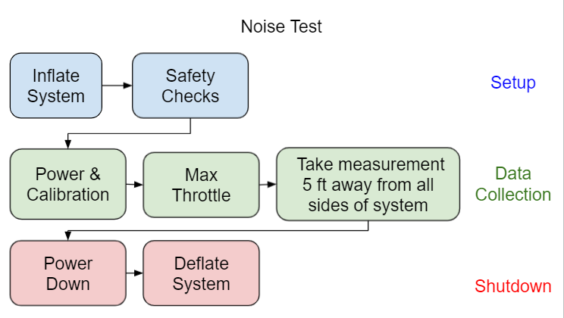
Process of conducted noise test
System Requirement: Noise Level
Expectation: The noise level of the system will be <75dB(the average for most drones), since the throttle will be lower and the propellers further apart. The results could be affected by echo of indoor environment
A flight test to determine the maximum noise level of the system was conducted with the following procedure
The data was collected with an Apple Watch Series 6 which has been shown to have an accuracy of ± 1% when compared to other noise sensors
Flow chart representation of the noise test, broken into three phases. Each box represents a high level step in the procedure

Slide 53
Detailed Future Noise test
Hidden slide
System Requirement: Noise Level
Procedure:
Layout envelope so that all brackets are on outskirts.
Inflation, Can be done with air since buoyancy is not required for this test
Safety Check
Assure that all attachments are securely
Attach tether to weight on ground
Power and calibration
If uncalibrated
Follow calibration steps
If calibrated
Turn power on
Flight test (timed portion)
Servos to upright position
Throttle to 29% (max thrust)
Take noise measurements 5 feet away all around the system
Turn off power switch
Deflate system
Calibration Steps
Set throttle curve to max at 100%
Throttle to 100% with system off
Turn system on
Wait for 2 beeps followed by third beep
Turn throttle to 0% within 2 seconds
Wait for 3 more beeps
Set throttle curved to max at 29%

Slide 54
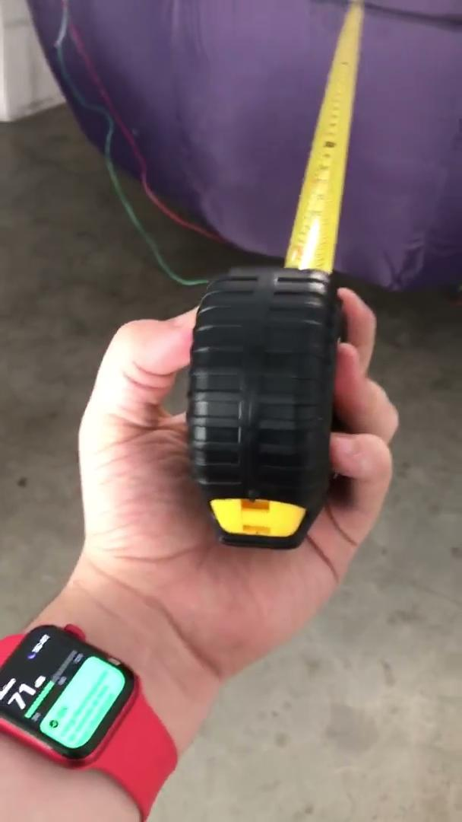
Results of Noise Test Don’t Meet Requirement
System Requirement: Noise Level
The noise test was successfully conducted. The test went very smoothly with no large factors of error noted. The test was conducted with the garage door open and closed. To see if there would be any difference between the two
Door Status | Max Noise Level
Closed | 76dB
Open | 72dB
Video of noise test
Garage open
Conclusion: The results of the Noise Test show that when motors are at full throttle, the system noise level reads a max of 76 dB when 5ft away. This is just over our required 65db. Since the lower dB reading was taken with the garage door open it could be theorized that if this test was conducted outdoors, an environment that the drone would actually be deployed in, the readings may meet the requirements but this has not been tested.

Slide 55
Helium Leakage Did Not Meet Requirement
Tested:Not Met
The lift bag shall maintain 90% of its buoyancy over a one week period
Our Helium leakage requirement was not met. System would lose 10% of its buoyancy in 1.25 hours nowhere close to our required 1 week.
Conclusion: When the lift bag was inflated the end was usually tied off with rubber bands and duct tape using this method the balloon would hold its for a few hours before noticeable slack appeared. However the collected data is not reflective of this method due to errors during testing with helium. Even so the helium loss in any latex balloon would not likely be able to meet this requirement due to the size of helium molecules.

Slide 56
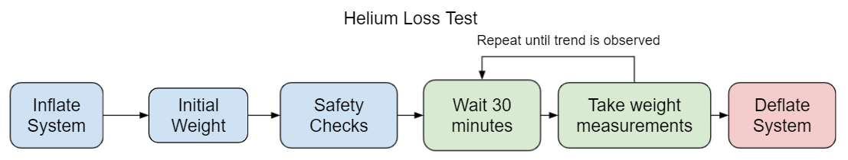
Helium Loss Test Procedures
System Requirement: Helium leakage
Expectation: Due to the size of helium molecules a latex balloon will not successfully be able to maintain its buoyancy for more than a few hours.
A flight test to determine the helium loss of the system over time was attempted with the following procedure
Flow Chart representing the procedure of the helium loss test with each block representing a high level step in the procedure

Slide 57
Detailed Future Helium loss test
Hidden slide
System Requirement: Helium leakage
Procedure:
Layout envelope so that all brackets are on outskirts.
Inflation
Since envelope is large then anticipated first the lift bag will be inflated until it is sphere with 1.5m diameter or 1.8m³ in volume
The rest of of the system will be filled with 4m³ of helium
Check weight of system
Safety Check
Assure that all attachments are securely
Attach tether to weight on ground
Wait for 30 minutes
Check weight of system
Repeat steps 5 & 6 several times to see if weight loss if linear or exponential
Deflate system
Find weight difference over time to estimate helium loss for 1 week

Slide 58
Results of Helium Loss Test
System Requirement: Helium leakage
Helium loss test likely did not provided accurate results
Due to errors with inflation helium hose was left attached to lift bag resulting wose seal then expected.
Due to Lift bag puncture only 2 data points where taken making rate of change for loss was unable to be determined
Time | Weight | Estimated helium in system | Percentage of helium lost
0min | 798g | 4.50m³ | 0%
30min | 960g | 4.356m³ | 4.2%
Conclusion:Helium loss test revealed a loss of 8.4% an hour however this is likely inaccurate due to testing errors, even so this does not come close to our requirement of manting 90% over 1 week.

Slide 59
Magnetometer Interference Requirement was Not Verified
Not Verified
Requirement: Magnetometer interference shall be less than 10nT
Motors are the main contributor to magnetometer interference
our use of low power electronics should reduce the generated electromagnetic interference.
We only had a week window with access to the magnetometer payload, but due to manufacturing delays, we were unable to conduct the test with the sensor.
Conclusion: Magnetometer interference not verified

Slide 60
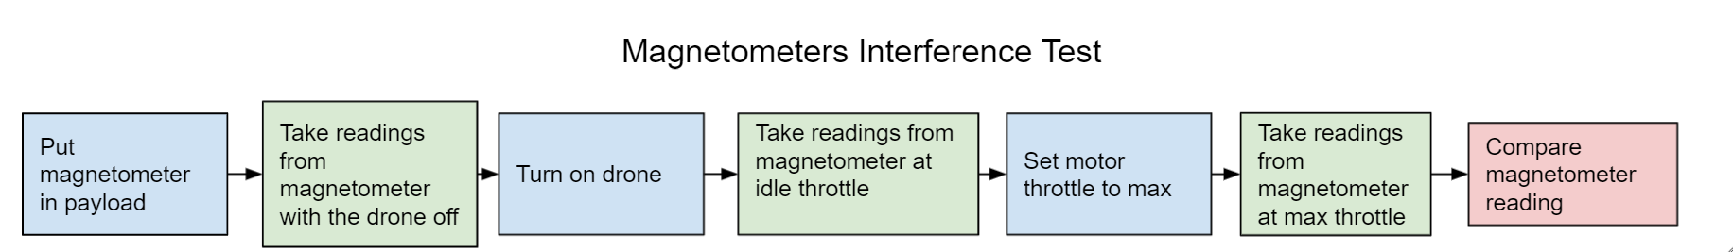
Possible Magnetometer Interference Test
System Requirement: Magnetometer Interference
Requirement: Magnetometer interference shall be less than 10nT
Expectation: Not sufficient enough research has been done on magnetic interference to have accurate expectation for this requirement.
An experiment with the following procedure could be conducted in order to test magnetometer interference on the magnetometer.
Additional data points could be taken between 0% and 100% throttle for more detailed data of how motors effect magnetometer interference

Slide 61
Cost of Drone Expected to Meet Requirement
Estimated Product Cost
The drone shall cost less than $10,000. Reach - The drone may cost less than $6,000
Total Materials Cost is : $1693.56
Battery Charger and Battery: $369.98
Passive components (resistors, capacitors, and voltage regulators): $30.95
Controllers, Processors, and Oscillators: $69.28
Sensors: $85.22
Actuators, Transmitters, and Receivers: $322.08
Screws, fabrics and materials, PCB fab: $809.37
Plug accessories (U.FL, pin headers, battery holder): $6.68
Estimated Fabrication Labor Costs
Outsourcing sewing of envelope (40 hours) - $800
PCB soldering could range from $1.34-$6.03 per board depending on bulk of order (PCBWay)
3d Printing Services (5 hours) - $100
Estimated Product Costs ~ $2600
Fabrication and labor costs are well under both $6000 and $10000 requirements, but overhead and marketing costs have not been taking into account.

Slide 62
Drone Safety Procedures Followed But Not Verified
Not Verified
The drone, its usage, and build should be safe to all individuals involved
Drone Safety requirement was not met since no successful flight test could verify.
Precautions to protect the System and its users.
Switching Regulators to protect electronics from heat damage
Will have to be verified that the electronics are not damaged as flight tests are conducted
Low Battery Detection to alert user
Low voltage alarm was attached to the side of the gondola and attached to the battery that will emit a loud alarm when battery voltage falls below 9.6V or 3.2V on any cell, however has not been verified with a flight test
Emergency shutdown feature
Manual power switch included on prototype drone gondola to disarm drone. Future iterations will require kill switch to be programmed on remote controller.
3D parts edgest where protected to prevent lift bag punctures
To prevent the mounting plates from popping the lift bag, a layer of bubble wrap was applied, and found to be successful, however a more permanent solution will need to be found.
Helium safely transported
Used a truck with straps to transport helium tank, while carrying it off the truck in a dolley and securely fastened with chain and lock for storage.
Noise Novel
Noise level always under 85dB, which is the level at which damage to the ear can start occuring
Precautions have been taken in order to make sure the drone is safe in operations, but until multiple test flights and a danger analysis is conducted, drone safety cannot be verified.

Slide 63
Legal Compliance Practices Were Followed
Not Verified
The drone and team shall abide by all applicable laws for drone flight
Legal compliance could not be confirmed since system was never completed
Legal practices that we took into account when designing and testing our system
Drone Insurance: would be provided by school for university related projects
FAA registration: We have not been registered with the FAA but we have operated our drone to meet the following requirements of statutory provision PL 115-254, section 350
Fly below 400 ft (always used tether)
Drone must always be flown while in sight of the user
Covid restrictions have been followed when operating in University Facilities such as Westside Research Park
Flight request forms will be filled out before any test flight conducted outside on the university premises
Although all legal practices have been followed during steps so far. Since the drone system is not complete it cannot be registered with the FAA and this cannot yet be verified.
Notes:
We took into account all safety precautions

Slide 64
fin.

